Slide 1
Chapter 1 The Worlds of Database Systems

Slide 2
Objectives
Understand concepts of:
Information, Data, Database
Database Management System (DBMS)
Database System

Slide 3
Contents
1.1 The Evolution of Database Systems
1.2 Overview of Database Management System

Slide 4

1.1 The Evolution of Database Systems
Data
Information
What are the differences between data and information?
Notes:
Data
Raw fact of things
No contextual meaning
Number, text,…
Information:
- Data with exact meaning
- Processed data and organized context

Slide 5
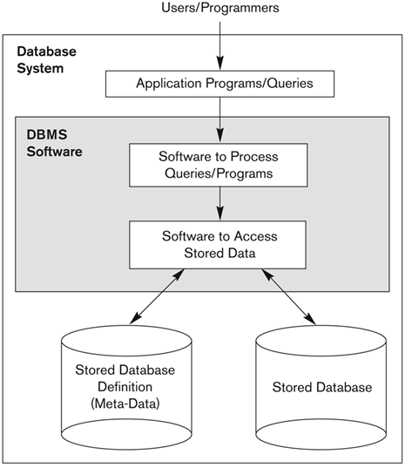
1.1 The Evolution of Database Systems
Database
A collection of information that exists over a long period of time.
A collection of related data.
managed by a DBMS
Database Management System (DBMS)
A software package/system to facilitate the creation and maintenance of a computerized database
Database System
The DBMS software together with the data itself. Sometimes, the applications are also included.
Notes:
Thông tin là những mô tả đặc trưng của 1 đối tương
Dữ liệu là những thông tin được lưu trữ ( để khai thác sau này)
Cơ sở dữ liệu: - tập hợp của các dữ liệu liên quan đến 1 hoặc nhiều đối tượng
- nó được tổ chức có cấu trúc để dễ khai thác sau này.
Hệ quản trị cơ sở dữ liệu:
Các chức năng : + cho phép tạo
+ truy xuất
+ quản trị CSDL

Slide 6
1.1 The Evolution of Database Systems
Early DBMS
1960s, the first DBMS based on file system
The DBMS is expected to
Allow users to create new databases and specify their schemas
Give users the ability to query the data
Support the storage of very large amounts of data
Enable durability
Control access to data from many users at once
Responsibility | Yes/No
(1) | Limited
(2) | Not directly supported
(3) | Yes
(4) | Not always supported
(5) | No

Slide 7
1.1 The Evolution of Database Systems
Hierarchical data model (tree-based model)
Was used in early mainframe DBMS
The IBM Information Management System (IMS) is example of a hierarchical database system
Student
S1
S2
Course
C1
C2
C2
C3
C4
Instructor
I1
I2
I2
I3
I1
Notes:
Mô hình: - CSDL quan hệ.
- CSDL hướng đối tượng.

Slide 8
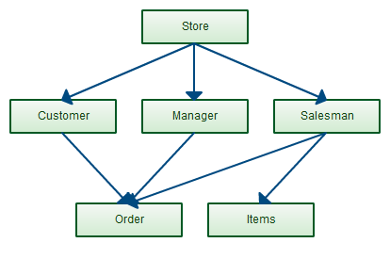
1.1 The Evolution of Database Systems
Network data model (graph-based model)
Charles Bachman invented in the late 1960s
standard specification published in 1969 by the Conference on Data Systems Languages (CODASYL) Consortium
The network model allows each record to have multiple parent and child records
→ Not support high-level query language

Slide 9
1.1 The Evolution of Database Systems
Relational Database Systems
1970s, Edgar Frank "Ted" Codd defined relational model based on relations (*)
Revolutionary idea of DBMS activity
at IBM (System R, DB2)
at Universities like Berkeley (Ingres)
SQL, the most important query language, was developed by IBM in 1974
1979, Oracle v.2, the first commercial RDBMS product using SQL

Slide 10
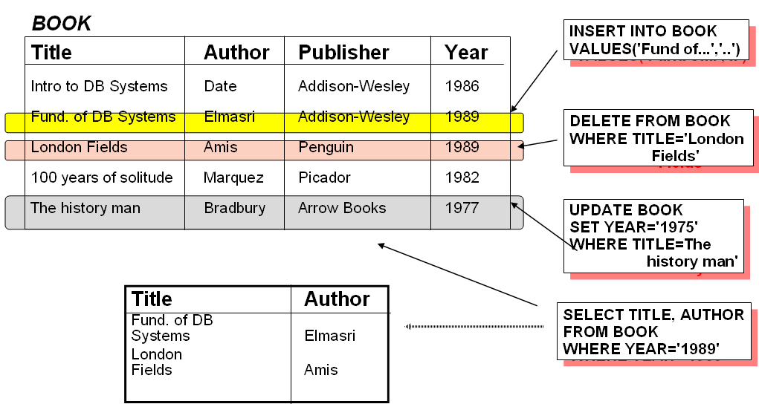
1.1 The Evolution of Database Systems
Book relation example

Slide 11
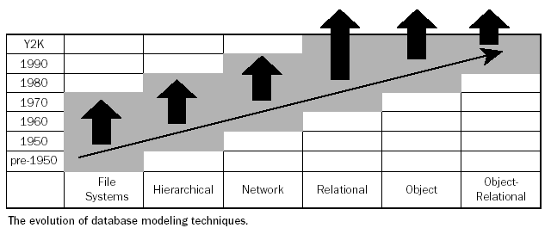
1.1 The Evolution of Database Systems
→ 2000s-now: NoSQL , newSQL

Slide 12
1.1 The Evolution of Database systems
Smaller and Smaller Systems
Originally, DBMS’s were large, expensive software running on large computers
Today, DBMS can run on PC, Mobile, …
⇒DB systems based on the relational model are available for even very small machines
Bigger and Bigger Systems
Size of data has been increasingly continuously
Many databases store petabytes and serve it all to users

Slide 13
1.1 The Evolution of Database systems
Information Integration
Join the information contained in many related databases into a whole
Example: a large company has many divisions, each division have built its own database of products and employees on different DBMS’s and different structures
How we join these databases without any matters
Need to build structures on top of existing databases, with the goal of integrating the information distributed among them

Slide 14
1.1 The Evolution of Database systems
Information Integration (con’t.)
Two popular approaches
Creation of data warehouses, where information from many databases is copied periodically, with the appropriate translation, to a central database
Implementation of a middleware (mediator) that support an integrated model of the data of the various databases, while translating between this model and the actual models used by each database

Slide 15
1.2 Overview of DBMS
Database Management System
DBMS components
Database Users
Database language
Relational databases

Slide 16
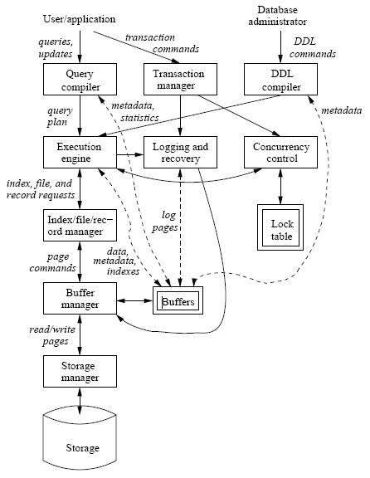
1.2 Overview of DBMS
DBMS components
Single box: system component
Double box: memory data structure
Solid line: control & data flow
Dashed line: data flow only

Slide 17
1.2 Overview of DBMS
Database Users
Database Administrators, authorize access to database, coordinate, monitor its use, acquiring software, and hardware resources, …
Database Designers, define the content, the structure, the constraints, and functions or transactions against the database
Database End users, use data for queries, reports and some of them actually update the database content

Slide 18
1.2 Overview of DBMS
DDL - Data Definition Language Commands
DBA needs special authority to execute schema-altering commands
Schema-altering commands are known as DDL commands, and used for defining data structure
These commands are parsed by a DDL compiler and passed to the execution engine, then goes through the index/file/record manager to alter the metadata (schema information for the database)
Examples: CREATE, ALTER, DROP

Slide 19
1.2 Overview of DBMS
DML - Data Manipulation Language Commands
Are used by computer programs or DB users to retrieve, insert, delete, and update data
Not affect the schema of the database, but affect the content of the database or extract data from database
DML has two separate subsystems
Answering the query
Transaction processing

Slide 20
1.2 Overview of DBMS
1. Answering the query
Query is parsed and optimized by the query compiler which the result is query plan
Query plan is passed to execution engine to execute
2. Transaction processing (will be discussed in the next chapters)
Transaction is a group of some database operations.
Transaction is processed by transaction manager.

Slide 21
The trends of DB design and DBMS
Non relational databases (NoSQL)
MongoDB
Redis
Multi-model databases
Oracle database
Arango DB

